Slide 1

University of Information Technology and Sciences
Simulation of a Bank Queue System
Team members information
Faculty
Md. Rasel Mia (2125051072)
S M Azizur Rahman(2125051078)
Md. Robiul Hasan(2125051088)
Md. Nafiul Bhuiyan (2044851019)
Ruhul Amin(2125051104)
Ms. Sonia Afroz
Lecturer, Department of CSE, UITS
Saima Siddique Tashfia
Lecturer, Department of CSE, UITS
1

Slide 2
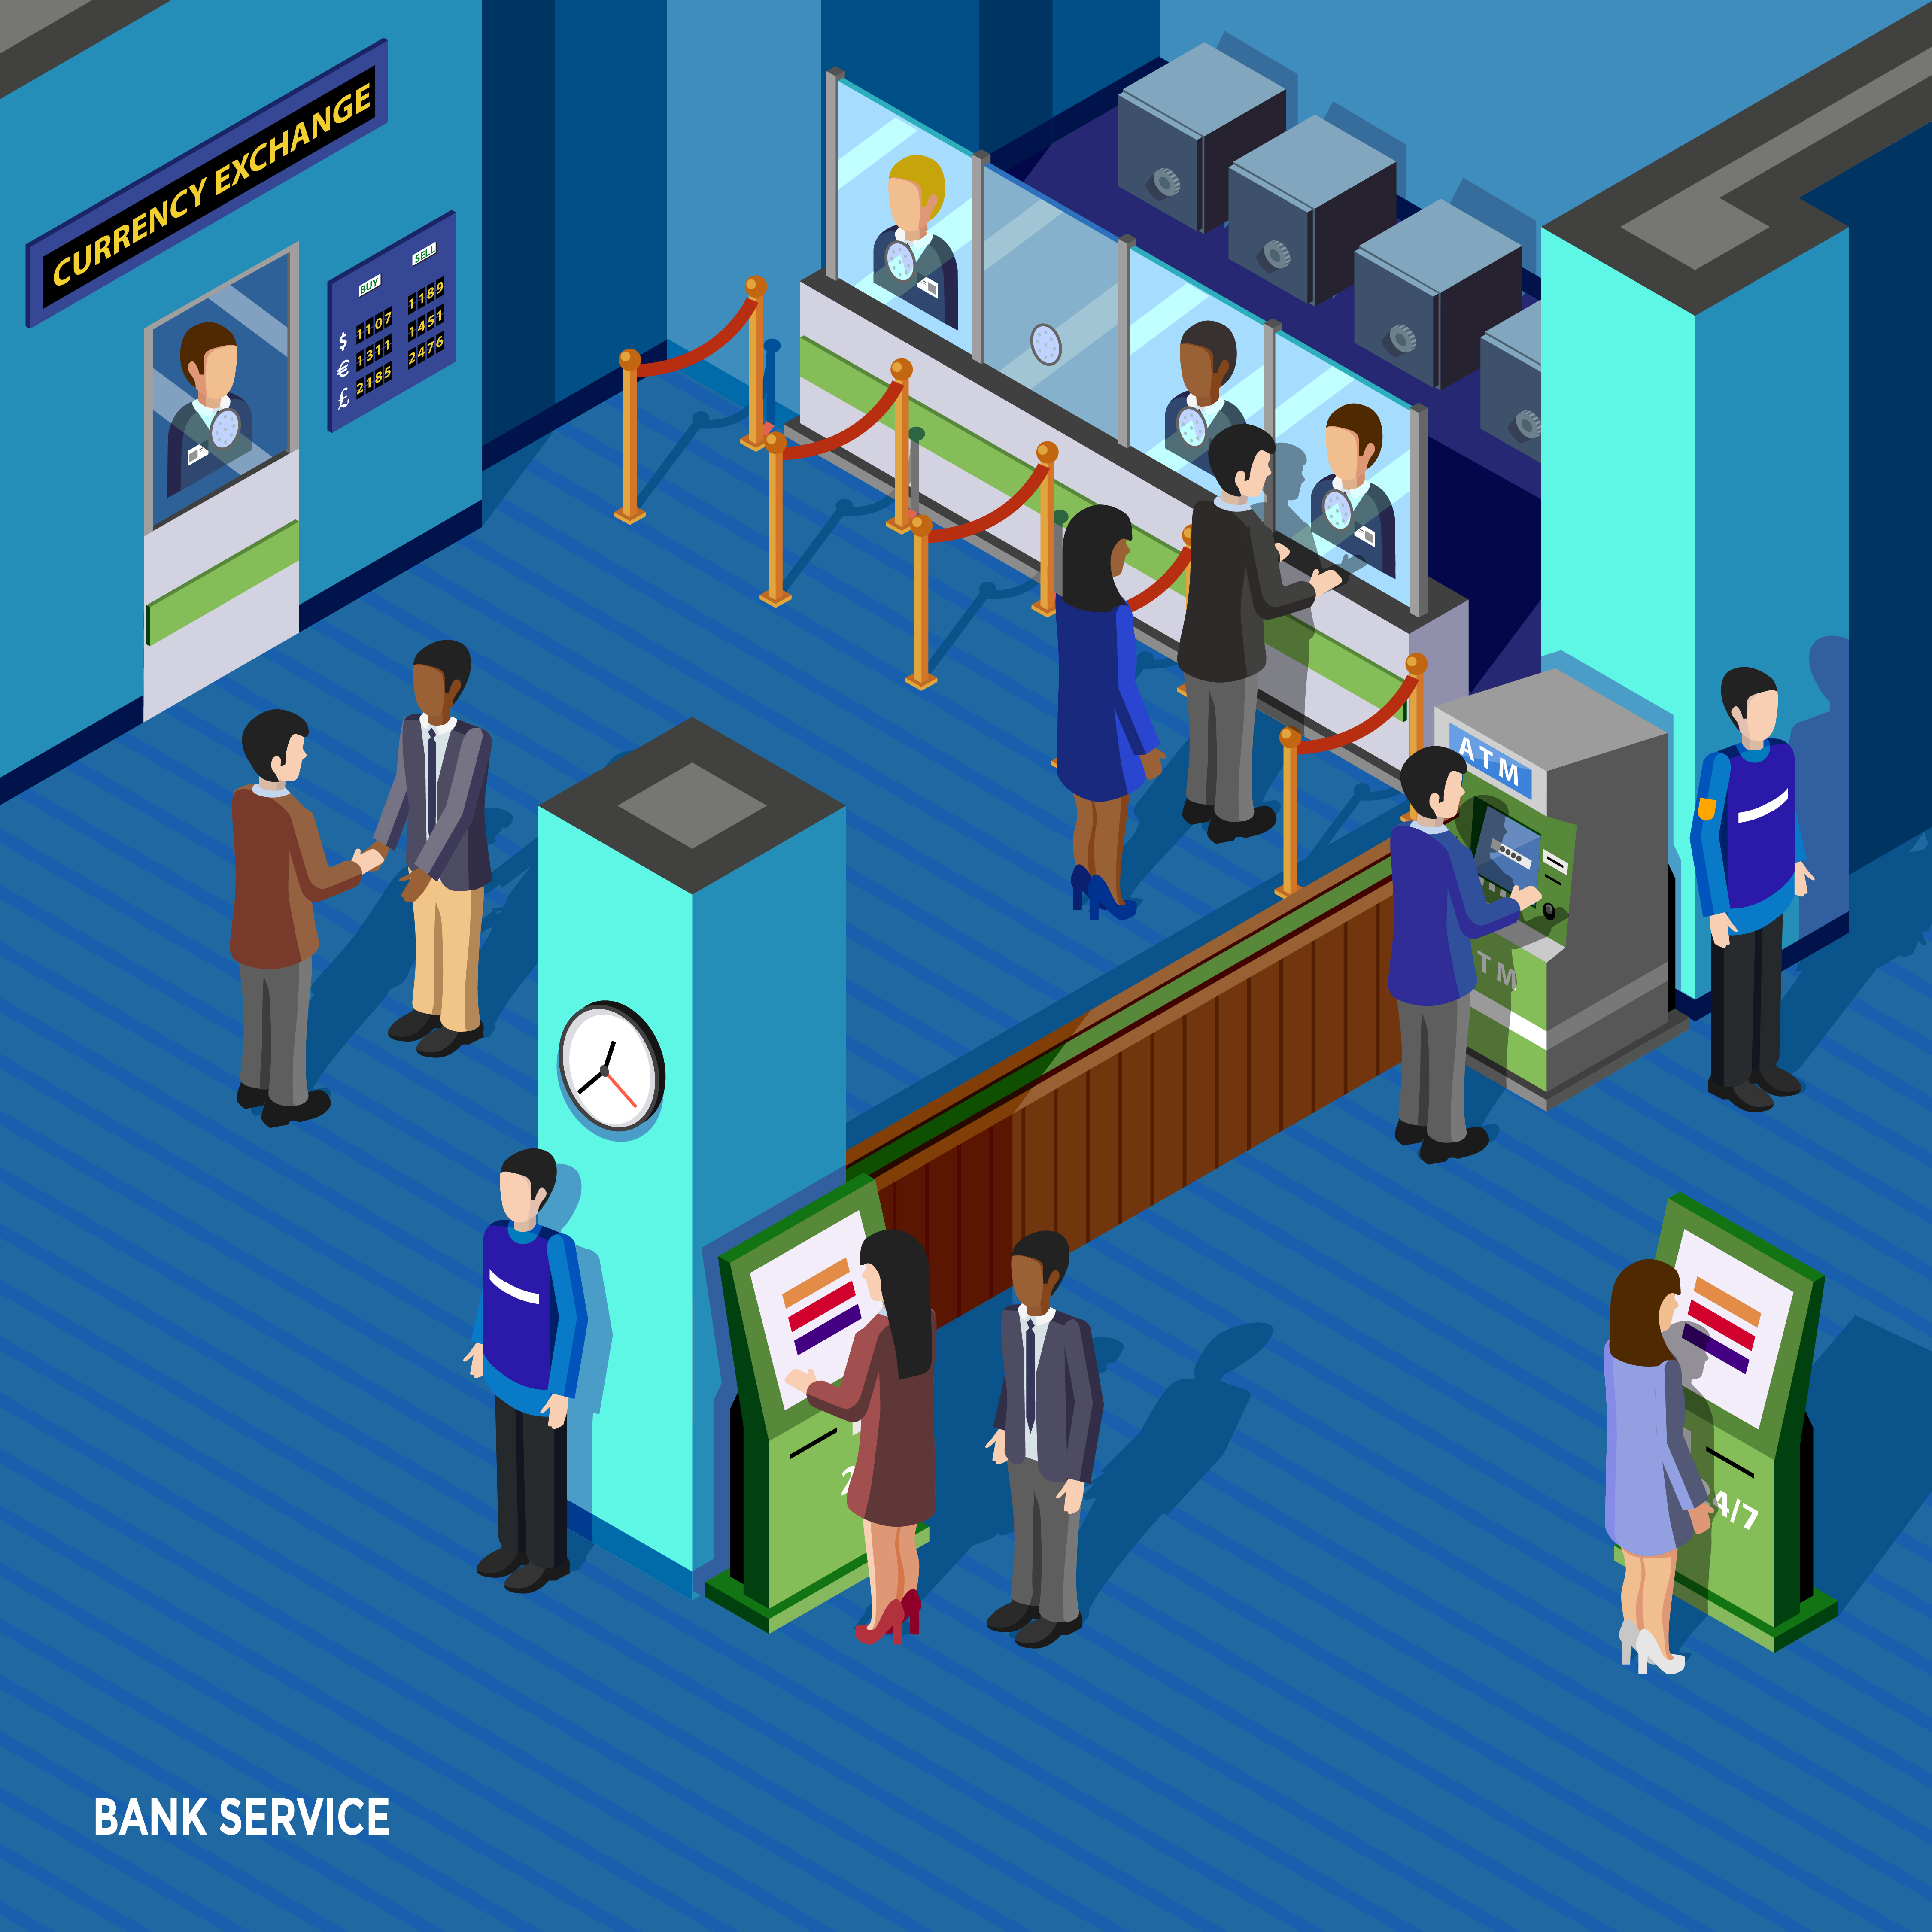
TABLE OF CONTENTS
Introduction
Problem Overview
Key Feature
Code Explanation
Results
Visualization
Conclusion
2
2

Slide 3
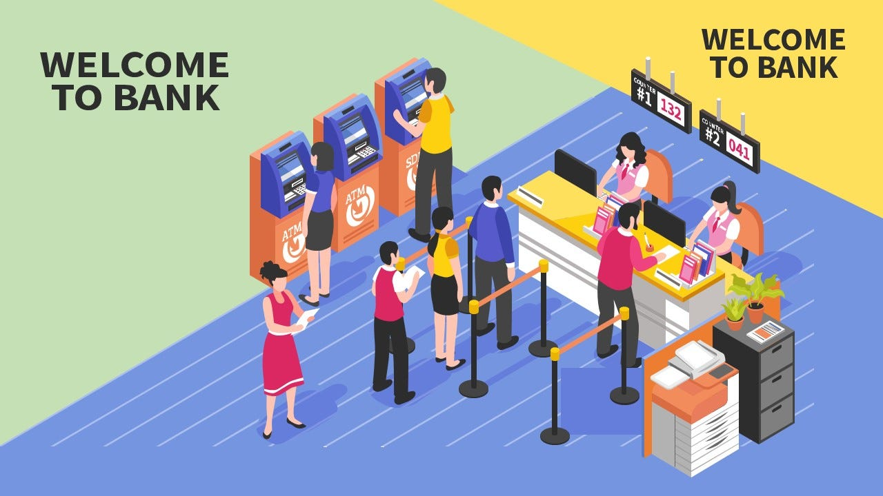
Introduction to Bank Queue Systems
What is Queue Simulation?
Purpose of This Simulation:
Why is it Important?
Analyze Customer Waiting Behavior.
Evaluate System Performance.
3

Slide 4

Problem Overview
1
Objective.
Waiting times (average and maximum).
Service efficiency (how well the counters handle the demand).
2
Scenario:
Customer Arrivals .
Service Process.
Queue Dynamics.
4

Slide 5

Key Feature
1
Realistic Modeling.
2
Multi-Counter System.
3
Dynamic Queue Management.
4
Performance Metrics.
5
Visualization.
5

Slide 6

Code Explanation
1. Initialization:
Simulation Parameters:
simulation_time = 3600: The simulation runs for 3600 seconds (1 hour).
arrival_rate = 1/15: On average, 1 customer arrives every 15 seconds.
service_rate = 1/20: On average, a counter takes 20 seconds to serve a customer.
num_counters = 3: There are 3 counters available for customer service.
6

Slide 7
Code Explanation
1. Initialization:
State Variables:
time = 0: Tracks the current simulation time.
queue = []: A list representing customers waiting in line.
counters = zeros(1, num_counters): An array to track the remaining service time for each counter (0 if idle).
total_customers: Tracks the number of customers who arrived.
served_customers: Tracks the number of customers who were served
waiting_times: A list to store the waiting time of each served customer.
7

Slide 8
Code Explanation
2. Simulation Loop:
Purpose:
Progress the simulation by handling customer arrivals and managing service at counters.
Customer Arrivals:
inter_arrival_time = exprnd(1/arrival_rate): Randomly generates the time until the next customer arrival based on an exponential distribution.
time = time + inter_arrival_time: Updates the simulation time.
If time > simulation_time, the loop exits, as no new customers are allowed after the simulation ends.
If within simulation time, the customer is added to the queue.
8

Slide 9
Code Explanation
2. Simulation Loop:
Service Handling:
For each counter:
If counters(i) == 0 (counter is idle) and the queue is not empty:
The first customer in the queue is dequeued (queue(1) is removed).
A random service_time is generated (exprnd(1/service_rate)).
The counter is set to this service time.
Waiting Time: The difference between the current simulation time (time) and the customer's arrival time is calculated and stored in waiting_times.
The served_customers counter is incremented.
Remaining service times for all counters are updated (counters = max(counters - inter_arrival_time, 0)), decrementing them by the inter-arrival time while ensuring no negative values.
9

Slide 10
Code Explanation
3. Metrics Calculation:
After the simulation ends:
Total Customers Arrived (total_customers): Total number of customers added to the queue.
Total Customers Served (served_customers): Customers successfully served before the simulation ended.
Average Waiting Time: Mean of the waiting_times array.
Maximum Waiting Time: Maximum value in the waiting_times array.
10

Slide 11
Results
Example Output (From Simulation):
Total Customers Arrived: 217
Total Customers Served: 217
Average Waiting Time: 1.77 seconds
Maximum Waiting Time: 50.89 seconds
Key Observations:
Compare the number of customers served to the total arrivals.
Evaluate if waiting times are within acceptable limits.
Identify any trends that indicate bottlenecks or inefficiencies.
11

Slide 12
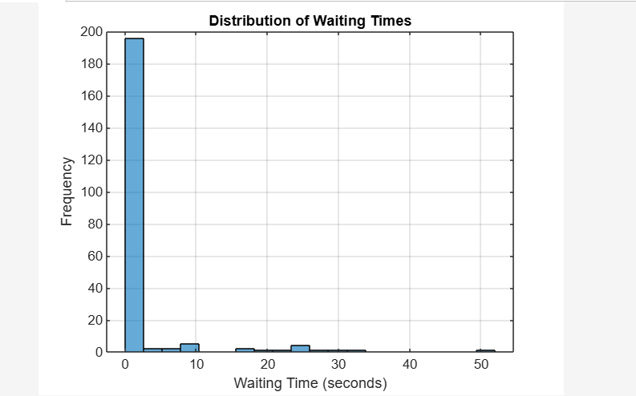
Visualization
1
Histogram of Waiting Times
Title: Distribution of Waiting Times
X-Axis: Waiting Time (seconds)
Y-Axis: Frequency
2
Description:
histogram represents the frequency of customer waiting times in the queue.
Insights:
Are most waiting times short?
Does the system occasionally experience long delays?
Analyze if the queue system efficiently manages customer arrivals and services.
3
Visual Element:
Include the histogram generated by the simulation code.
Ensure the chart is clear with labeled axes and a grid for readability.
12

Slide 13

Conclusion:
Recap of Key Findings:
Queue System Performance:
Balancing Arrival and Service Rates:
Future Work:
Experiment with Different Parameters:
.
Analyze Under Peak-Load Scenarios:
13

Slide 14

14

Slide 15

Any Question?
15

